Slide 1

Digital Transformation Programme
TechHub Electronics – connected omnichannel retail transformation
Project focus
Modern e-commerce, OMS/ATP, WMS, POS/store integration, trusted data, BI and change management.
Goal: connect the website, stores and warehouse so customers receive reliable stock promises and a seamless order journey.
Business need
TechHub must move from disconnected channels to one controlled retail operating model.
65
stores
$280m
revenue basis
850
employees
Recommendation
Proceed with a pilot-first, stage-gated delivery programme that proves value before full scale rollout.
36
months
$18.6m
budget
6
gates
BCS Capstone Project | TechHub Electronics
1

Slide 2
Business need: why TechHub must transform
Disconnected channels are constraining growth, reliability and operational control.
1
Online growth is constrained
Only 8% of revenue is online; the website needs stronger search, comparison, checkout, tracking and returns.
Need: Modern e-commerce experience
Business need
TechHub needs a connected retail model because customers expect the website, stores and warehouse to work as one service.
Without change, the business risks lost online sales, unreliable stock promises, manual work, fulfilment delays and inconsistent customer service.
Therefore, the transformation must focus on reliable availability, controlled fulfilment, trusted data and safe adoption.
2
Stock promises are unreliable
Store and warehouse stock records do not always agree, creating overselling, excess stock and weak customer promises.
Need: OMS + ATP with reservations
3
Fulfilment lacks end-to-end visibility
Warehouse and store fulfilment need scanning, status updates and controlled click-and-collect / delivery handling.
Need: WMS + store execution control
4
Data and service view is fragmented
Customer, consent, product, price and order information is separated, slowing service and management decisions.
Need: Master data, CRM/consent and Power BI
5
Large change must be controlled
65 stores and 850 employees are affected, so rollout must be phased with training, support and decision gates.
Need: Pilot-first rollout and change plan
Transformation focus: protect revenue, improve customer trust, reduce manual effort and create one reliable management view.
BCS Capstone Project | TechHub Electronics
2

Slide 3
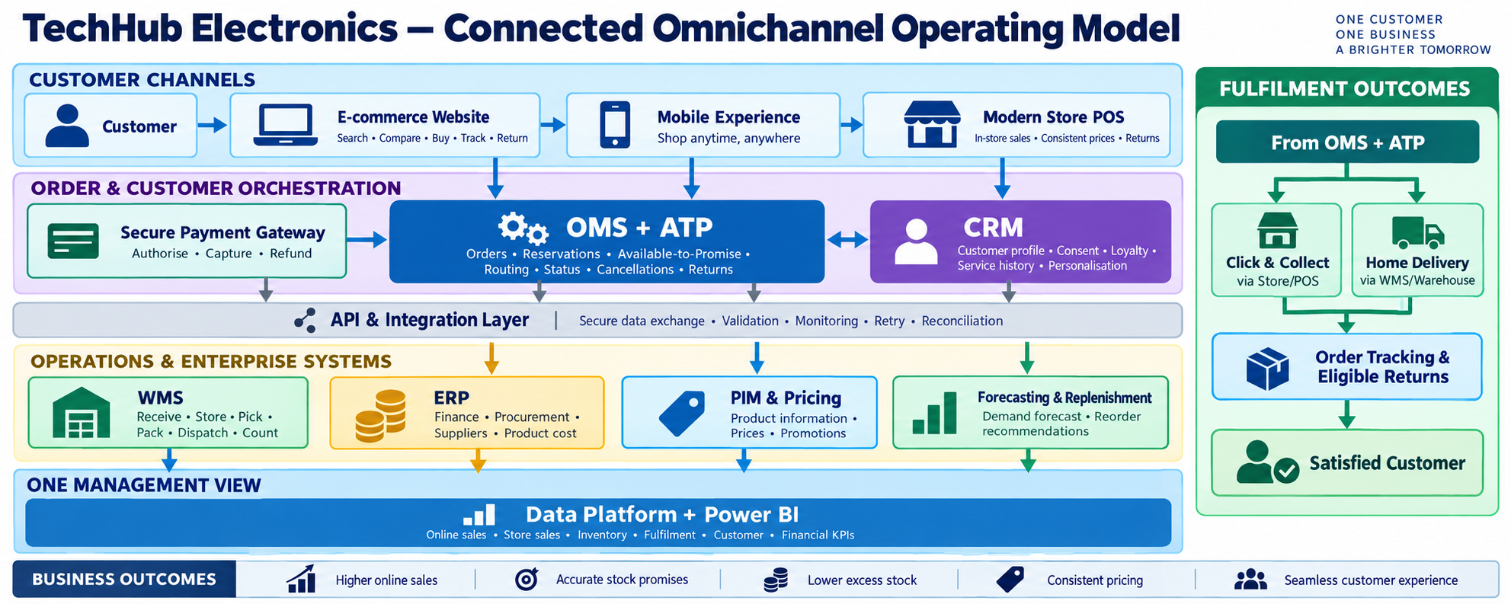
TECHHUB ELECTRONICS | PROJECT PRESENTATION
Connected omnichannel operating model
Regenerated visual applied to present the future-state model more clearly.
Focus: customer channels, OMS + ATP, fulfilment outcomes, enterprise systems and management reporting.
BCS Capstone Project | TechHub Electronics
3

Slide 4
TECHHUB ELECTRONICS | PROJECT PRESENTATION
Target system design
A cleaner future-state view using minimal arrows and clearer grouping.
The future-state model is organised into four simple layers that support one connected customer journey.
CUSTOMER CHANNELS
Responsive website
Stores & POS
Customer service
Delivery & returns
Reservations and stock promises
ORDER ORCHESTRATION
Commerce & content
OMS + ATP
CRM / consent
Pricing & promotions
FULFILMENT EXECUTION
WMS operations
Store fulfilment
ERP / finance
Carriers & suppliers
Shared updates feed reporting and control
DATA, INTEGRATION & CONTROL
Integration platform
Master data
Power BI & forecasting
Security & monitoring
Better customer promise
Stronger fulfilment control
Trusted management insight
BCS Capstone Project | TechHub Electronics
4

Slide 5
Recommended technology stack
Preferred platform choices aligned to the transformation scope.
Customer channels
Responsive e-commerce website, mobile web, Store Commerce / POS and service touchpoints
Do not replace ERP first
Start with fit-gap and integration; avoid unnecessary core risk.
CRM is conditional
Release if discovery confirms customer, consent and loyalty value.
Commercial platforms first
Configure proven platforms instead of custom-building the core.
Commerce, OMS & ATP
Dynamics 365 Commerce + Distributed Order Management + Inventory Visibility
Warehouse execution
Dynamics 365 Supply Chain Management WMS + handheld scanning devices
Customer service & CRM
Dynamics 365 Customer Service + Customer Insights as a conditional customer/consent release
Data, analytics & AI
Power BI / Fabric, demand planning, forecasting and replenishment insights
Platform & controls
Azure integration, identity, monitoring, security, privacy and payment controls
Outcome: scalable and supportable retail platform.
BCS Capstone Project | TechHub Electronics
5

Slide 6
Delivery roadmap – 36 months
Three simple phases, six decision gates and pilot-first rollout.
PHASE 1
Foundation
Months 1–9
PHASE 2
Pilot & launch
Months 10–24
PHASE 3
Scale & optimise
Months 25–36
Discovery and baselines
Requirements and process design
Data, security and architecture
Vendor fit-gap and approval
Website + WMS pilot
OMS / ATP and stock visibility
POS / store fulfilment integration
Training and change support
65-store omnichannel rollout
Conditional CRM / service integration
BI, forecasting and optimisation
BAU handover and benefits sustainment
G1
G2
G3
G4
G5
G6
Baseline
Design
Build
Pilot exit
Rollout
Handover
BCS Capstone Project | TechHub Electronics
6

Slide 7
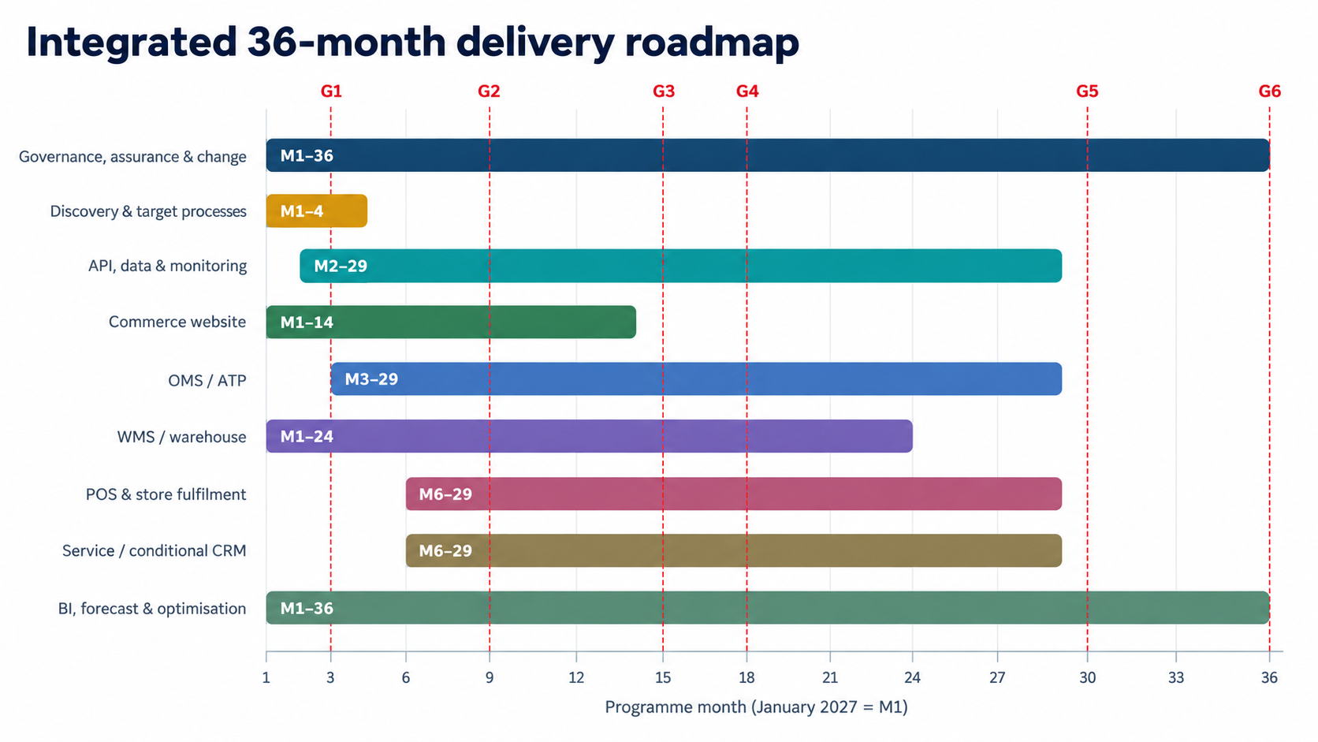
TECHHUB ELECTRONICS | PROJECT PRESENTATION
Detailed 36-month roadmap
Workstreams, delivery months and decision gates for controlled rollout.
Foundation first, pilot/launch second, then scale and optimise with gates G1–G6.
BCS Capstone Project | TechHub Electronics
7

Slide 8
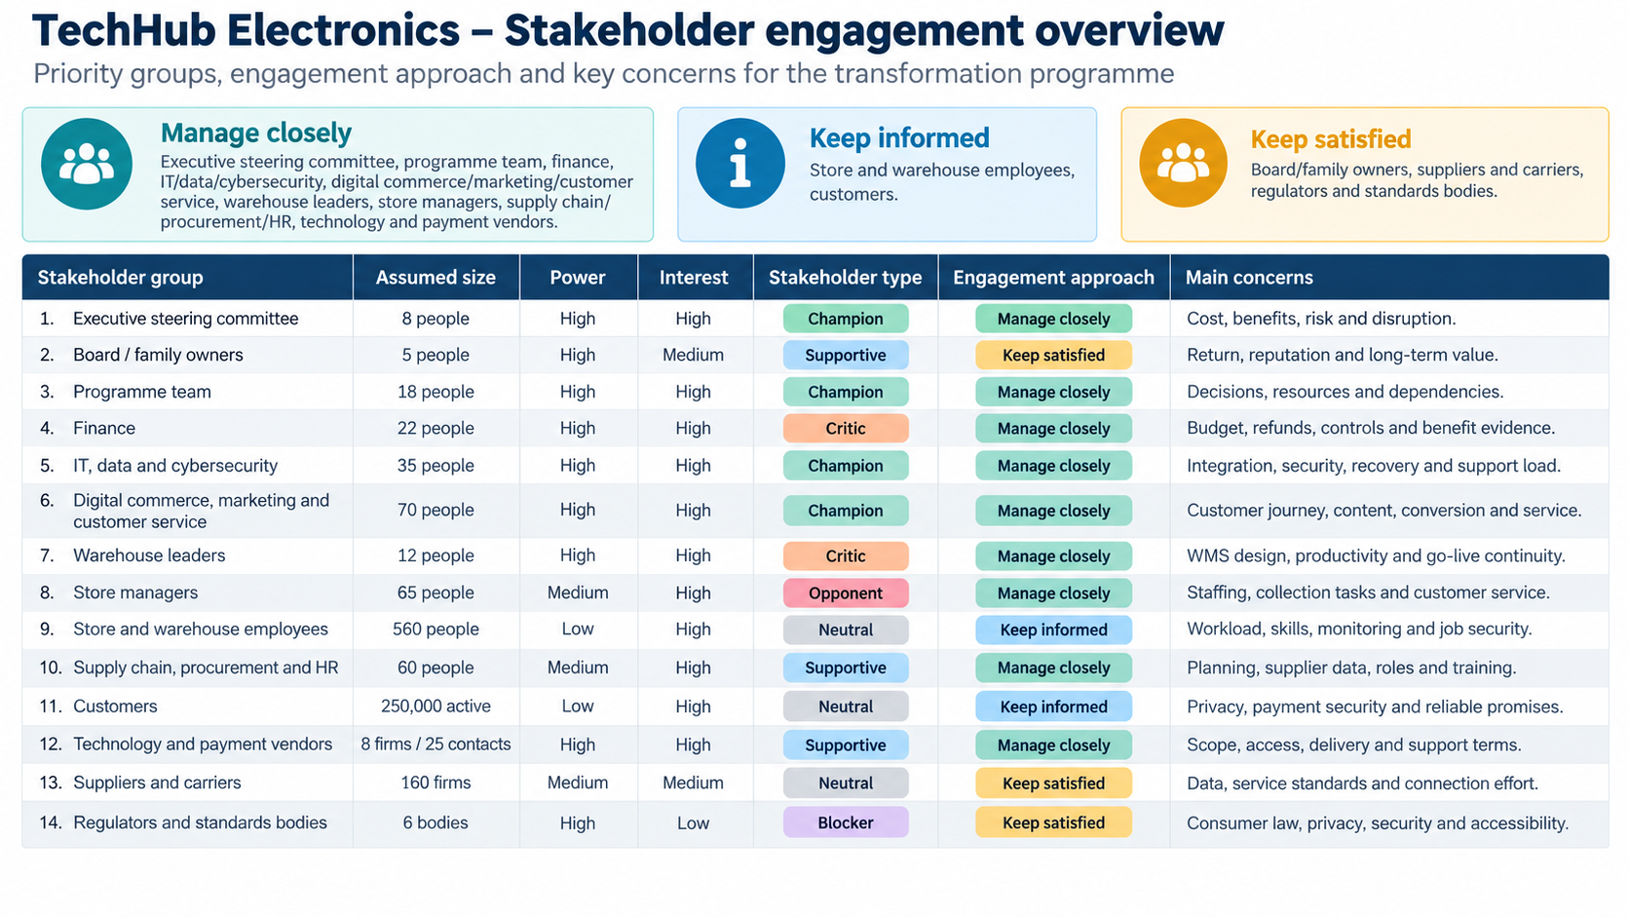
TECHHUB ELECTRONICS | PROJECT PRESENTATION
Stakeholder engagement overview
Priority groups, engagement approach and main concerns.
BCS Capstone Project | TechHub Electronics
8

Slide 9
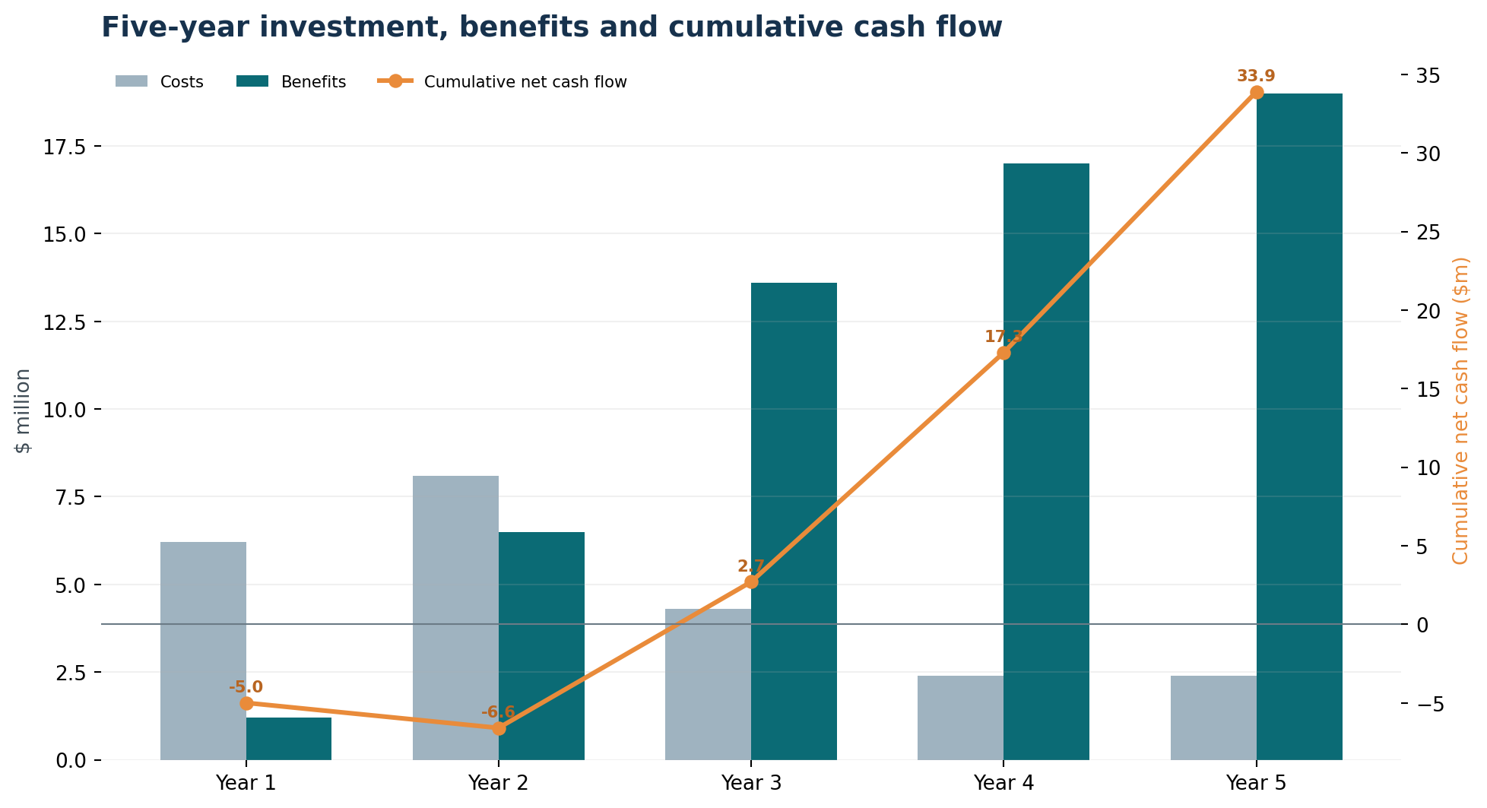
Benefits, measures and recommendation
Clear success measures and commercial rationale.
Key targets by Month 36
Digital revenue contribution
8% → 20%
Warehouse inventory accuracy
≥98.5%
Collection orders ready on time
≥95%
Stock message processing
≥99.5%
Employee adoption / proficiency
≥90%
$18.6m
budget
14.5%
3-year ROI
M33
payback
Recommendation: proceed with staged implementation, pilots, controlled rollout and benefits tracking.
BCS Capstone Project | TechHub Electronics
9

Slide 10
TECHHUB ELECTRONICS | PROJECT PRESENTATION
Investment and benefits projection
Three-year cost profile, projected benefits and payback summary.
These tables show the programme investment, expected benefits, net gain and estimated payback timing.
7.1 Three-year investment breakdown
Investment category | Year 1 | Year 2 | Year 3 | Total
Software licences / subscriptions | $1.2m | $1.5m | $1.6m | $4.3m
Hardware and infrastructure | $0.9m | $1.3m | $0.4m | $2.6m
Implementation and integration services | $2.3m | $2.9m | $1.2m | $6.4m
Data migration, testing and security | $0.6m | $0.8m | $0.3m | $1.7m
Training and change management | $0.4m | $0.6m | $0.3m | $1.3m
Internal programme resources | $0.5m | $0.6m | $0.3m | $1.4m
Contingency reserve | $0.3m | $0.4m | $0.2m | $0.9m
Total investment | $6.2m | $8.1m | $4.3m | $18.6m
Commercial summary
$18.6m
Total investment
$21.3m
Total benefits
$2.7m
Net benefit
7.2 Benefits projection
Benefit category | Year 1 | Year 2 | Year 3 | Total
Revenue growth benefits | $0.6m | $3.2m | $7.2m | $11.0m
Inventory cost savings | $0.1m | $0.8m | $1.8m | $2.7m
Warehouse efficiency gains | $0.1m | $0.7m | $1.5m | $2.3m
Service, reporting and marketing efficiency | $0.4m | $1.8m | $3.1m | $5.3m
Total benefits | $1.2m | $6.5m | $13.6m | $21.3m
Payback view
ROI (3 years)
14.5%
Estimated payback
Around Month 33
BCS Capstone Project | TechHub Electronics
10

